Slide 1
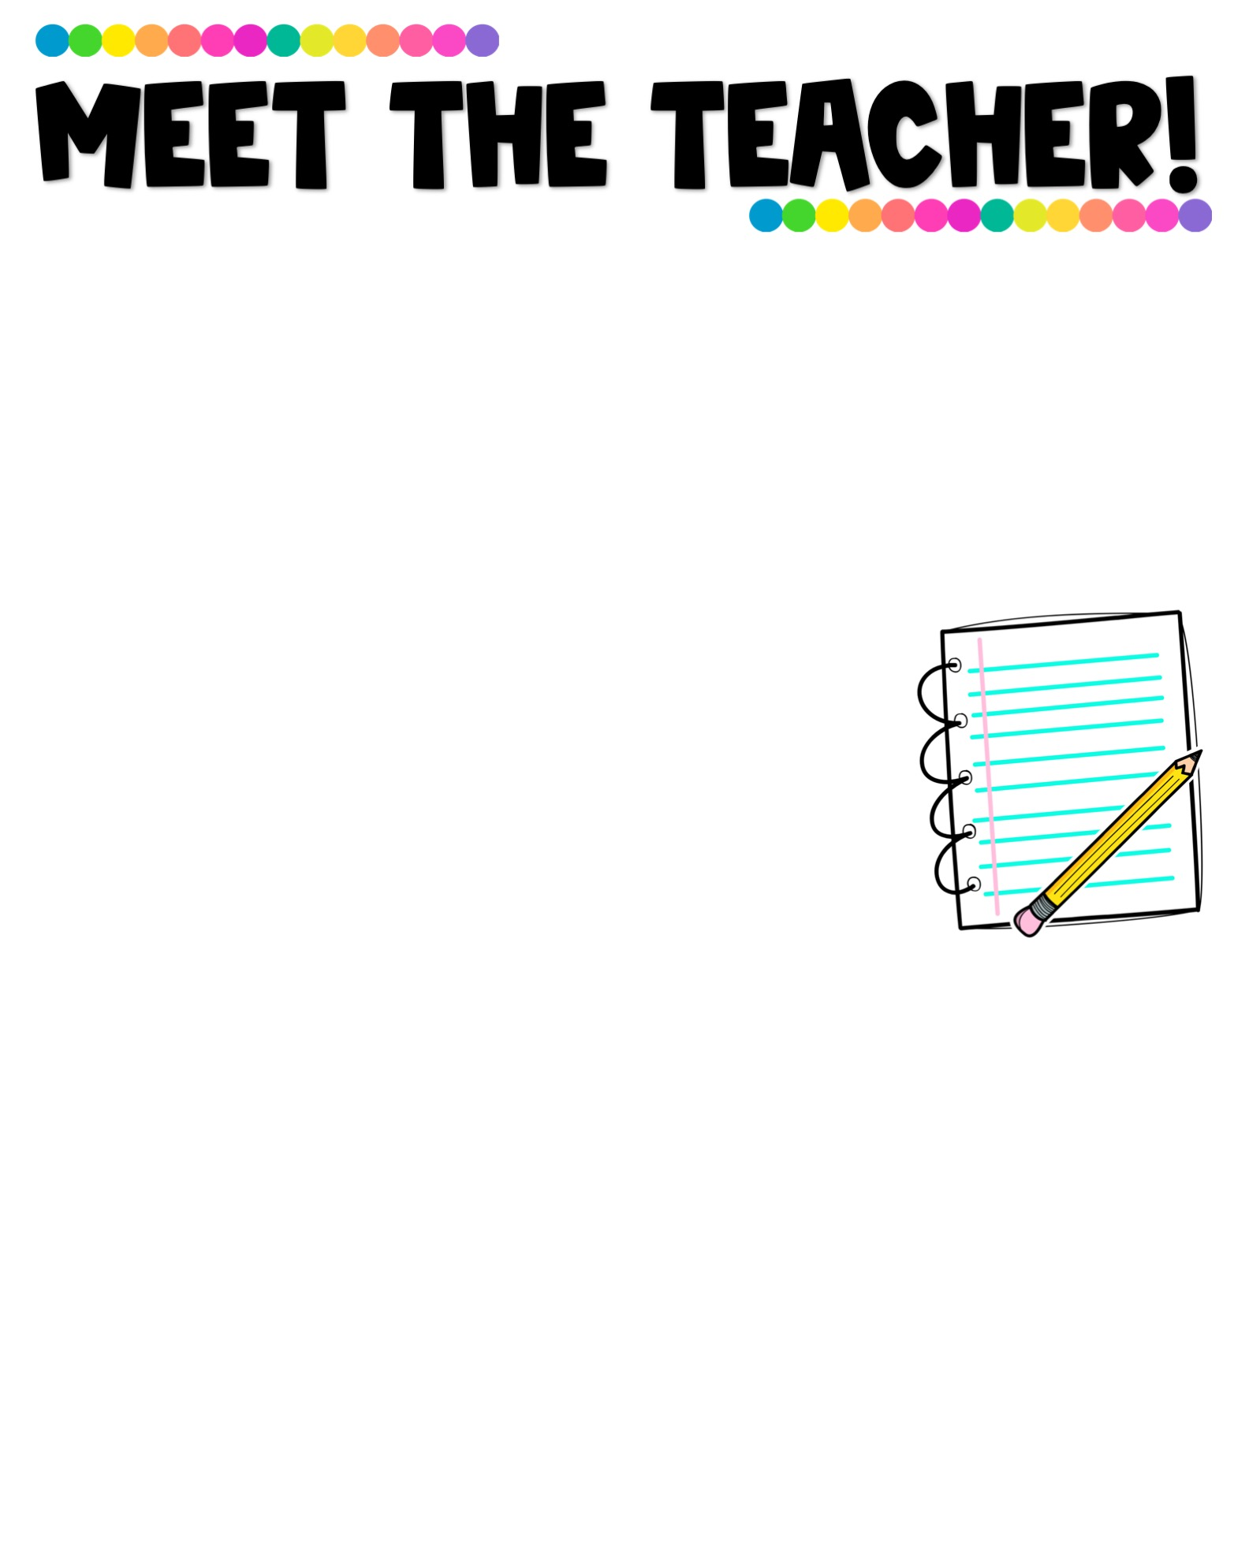
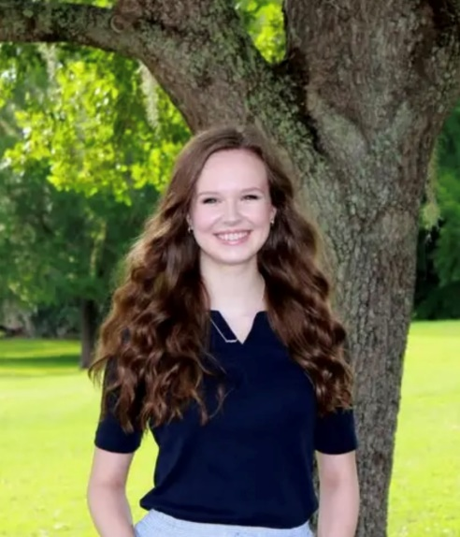
The Basics!
Ms.
Centers
Hi! My name is Paige Centers and I am so excited to be your fifth grade teacher! I graduated with my bachelor’s degree in Social Science Education from Florida State University and have taught elementary school in Leon County for three years. This will be my second year teaching fifth grade here at Conley!
I am very passionate about helping students succeed and love watching them achieve their full potential. In my free time, I love teaching ballet , spending time outside, hanging out with family, and reading!
Contact me!
My Favorites!
Food: Pizza
Flower: Sunflowers
Movie: The Emperor’s New Groove Book: “Jane Eyre” by Charlotte Bronte Color: Green
Drink: Coffee
Subject: History
Store: Target
Email: centersp@leonschools.net
Phone: 850.410.5610
It is easiest to reach me via email as it is difficult to take unscheduled calls throughout the day.
I can be reached Monday-Friday, from 8:00 am-4:00 pm

